Slide 1
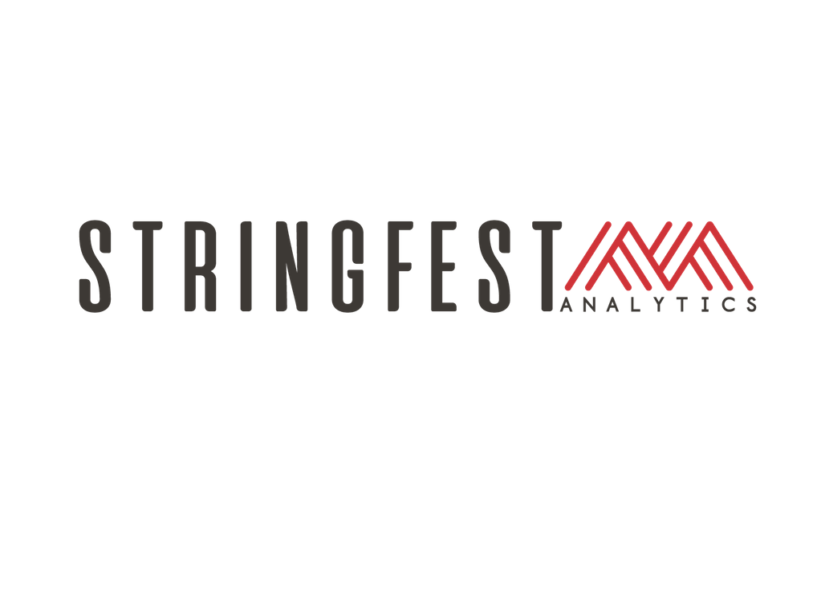

ADVANCING INTO ANALYTICS
Notes:
Welcome, in next couple slides I’ll say a little more about where I’m coming from and then we’ll look at the objectives for the presentation and so forth.

Slide 2

George Mount
Founder, Stringfest Analytics
Data analyst & educator
Analytics education blog: stringfestanalytics.com
Building analytics courses & communities
Notes:
I’m George, I run Stringfest Analytics. My goal is really to help people and organizations get better at data, I was a junior analyst once and was totally overwhelmed and shocked at what I needed to do at data and how much I wasn’t ready for. So that just kind of stuck with me and I thought about what a market solution might look like. That in large part started with my blog, check it out. I post there a lot about analytics and analytics education. And things have just grown and grown from there. The book has been a cool new project and I’m excited to share a little bit about it here, so this is what I have in store on next slide:

Slide 3

OBJECTIVES FOR TODAY
Why Advancing into Analytics?
Objectives
Pre-requisites
A tour of the book
Conclusion
Resources
What’s with the bird?
Advancing into Analytics
Notes:
First I’d like to set the stage for why I wrote it in the first place, along with the basics of who it’s for and what they should know before getting started.
Then I’ll provide a quick tour of the book, this will also be good context for where I’m coming from and what I hope this book to do for you and for the community.
Finally I’ll leave you with some resources for getting to the book, I’ll take questions, and I know one question already will be what’s with the bird, so I’ll go over that.

Slide 4
WHY ADVANCING INTO ANALYTICS?
Notes:
OK, so why did I write this book? Let’s find out.

Slide 5
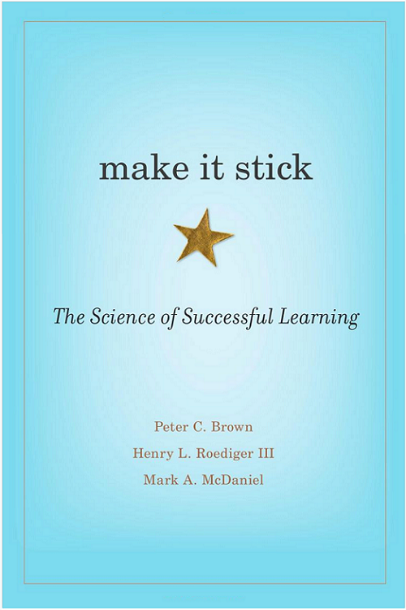
MAKE STRAIGHT THE PATH
“The more you can explain about the way your new learning relates to your prior knowledge, the stronger your grasp of the new learning will be, and the more connections you create that will help you remember it later.”
-- Brown et al., Make it Stick: The Science of Successful Learning
Notes:
Now I wasn’t a huge math student in school but I always kinda liked statistics and building models. R and Python seemed like natural fits for getting into that line of work but I really didn’t find good content for that as an Excel user. Too much of it was quite disparaging about using Excel in the first place rather than use that as a really cool jumping-off point.
So my goal for this book was to make that a really clear path from Excel to R and Python.

Slide 6
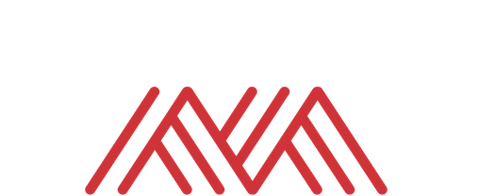
LEARNING OBJECTIVE
“By the end of this book, you should be able to conduct exploratory data analysis and hypothesis testing using a programming language”
Data visualization
Summary statistics
Probability
Inferential statistics
Data cleaning & manipulation
Notes:
Specifically to do this. I have the learning objective right here in the preface.
Now this learning objective if you break it down requires quite a lot of skills.
We’re able to fulfill all these things because of that straight learning path, but there are some prerequisites

Slide 7
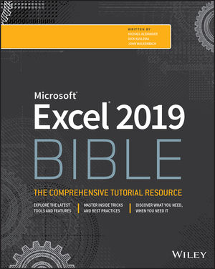
PRE-REQUISITES
Absolute, relative, and mixed cell references
Conditional logic and conditional aggregation (IF() statements, SUMIF()/SUMIFS(), and so forth)
Combining data sources (VLOOKUP(), INDEX()/MATCH(), and so forth)
Sorting, filtering, and aggregating data with PivotTables
Basic plotting (bar charts, line charts, and so forth)
Notes:
If this sounds good, you may be interested in this, now is it for you? Here are my technical pre-requisites, it does require some Excel. And if you need practice with these topics, I suggest this book.

Slide 8
A TOUR OF THE BOOK
Notes:
OK, now let’s take a quick tour through the book, it’s 3 Parts and 14 chapters.

Slide 9
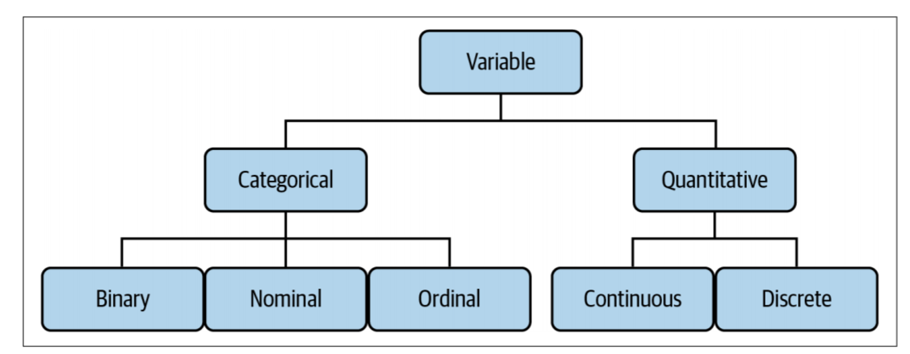
I. FOUNDATIONS OF ANALYTICS IN EXCEL
Foundations of Exploratory Data Analysis
Foundations of Probability
Foundations of Inferential Statistics
Correlation and Regression
The Data Analytics Stack
Notes:
First part is done in Excel. We’ll start with exploratory data analysis. So when you are confronted with a new dataset you have some framework for sizing up the variables, summarizing and visualizing them and so forth.

Slide 10
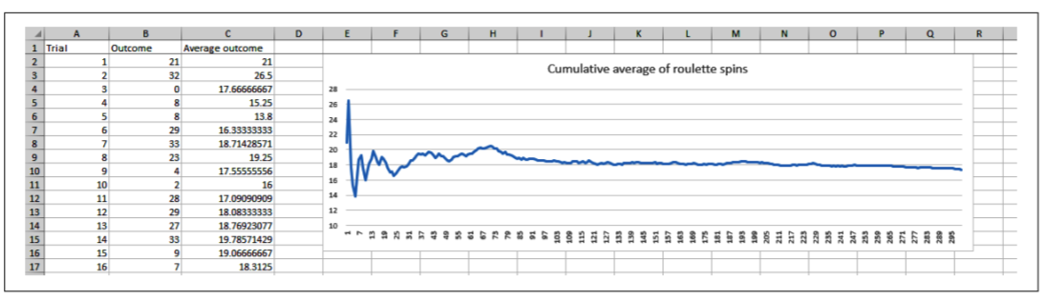
I. FOUNDATIONS OF ANALYTICS IN EXCEL
Foundations of Exploratory Data Analysis
Foundations of Probability
Foundations of Inferential Statistics
Correlation and Regression
The Data Analytics Stack
Notes:
Next is probability. So this chapter sounds pretty intimidating but I try to make it very hands on and fun. You’ll learn a bit about probability distributions, especially the normal distribution and things like the central limit theorem and law of large numbers because the normal distribution is super important for inferential statistics…

Slide 11
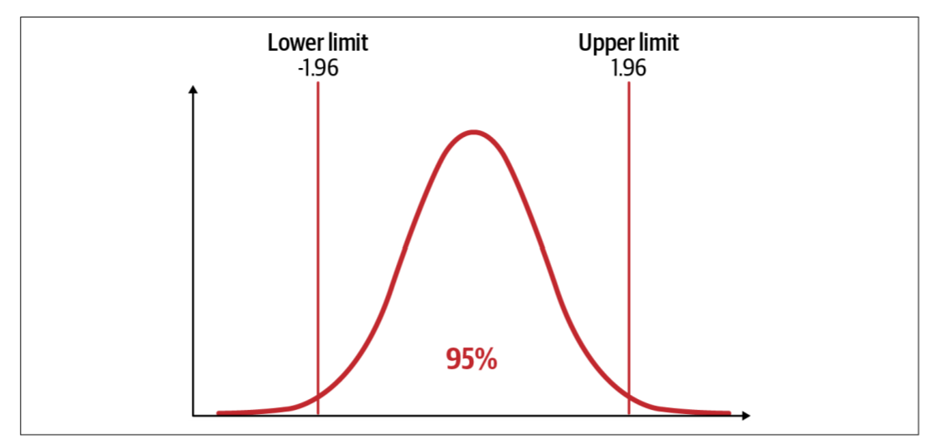
I. FOUNDATIONS OF ANALYTICS IN EXCEL
Foundations of Exploratory Data Analysis
Foundations of Probability
Foundations of Inferential Statistics
Correlation and Regression
The Data Analytics Stack
Notes:
Next you’ll learn a bit about inferential statistics, so you’re still in Excel, and if concepts like the p-value and statistical significance don’t make sense, please check this chapter out and I think this will help.

Slide 12
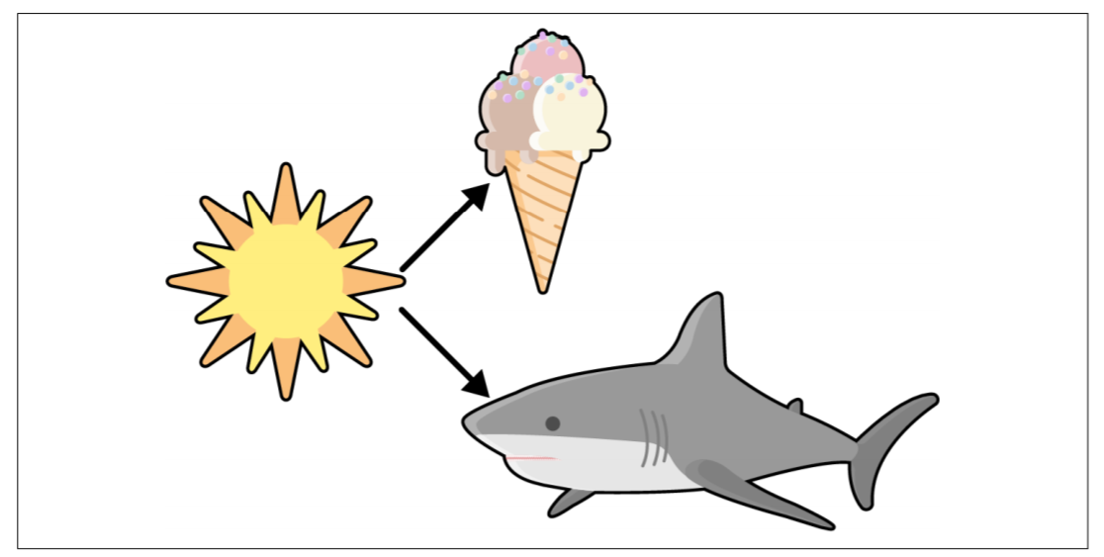
I. FOUNDATIONS OF ANALYTICS IN EXCEL
Foundations of Exploratory Data Analysis
Foundations of Probability
Foundations of Inferential Statistics
Correlation and Regression
The Data Analytics Stack
Notes:
You may have heard that correlation does not imply causation. But what does this really mean? You’ll learn a bit about correlation and regression here.

Slide 13
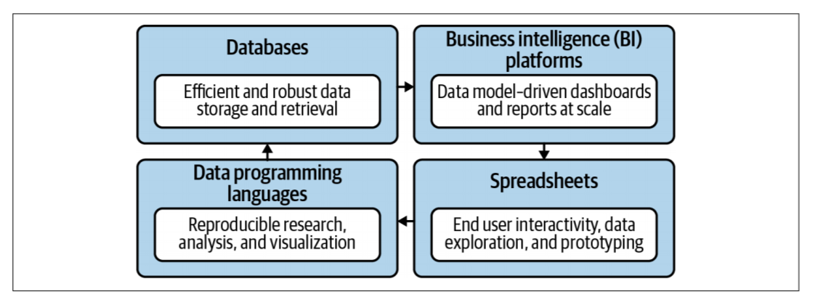
I. FOUNDATIONS OF ANALYTICS IN EXCEL
Foundations of Exploratory Data Analysis
Foundations of Probability
Foundations of Inferential Statistics
Correlation and Regression
The Data Analytics Stack
Notes:
Now this is more of a conceptual chapter. It will help you situate Excel, R and Python all in what I call the broader data analytics stack.

Slide 14
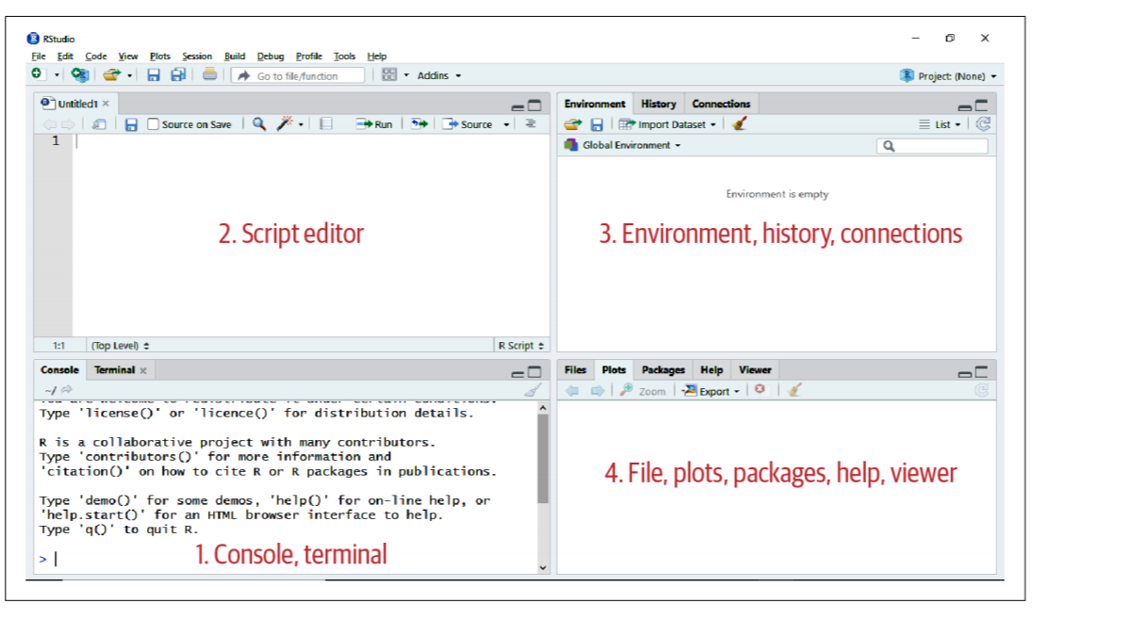
II. FROM EXCEL TO R
6. First Steps with R for Excel Users
7. Data Structures in R
8. Data Manipulation and Visualization in R
9. Capstone: R for Data Analytics
Notes:
Here will be an introduction to R coding and Rstudio.

Slide 15
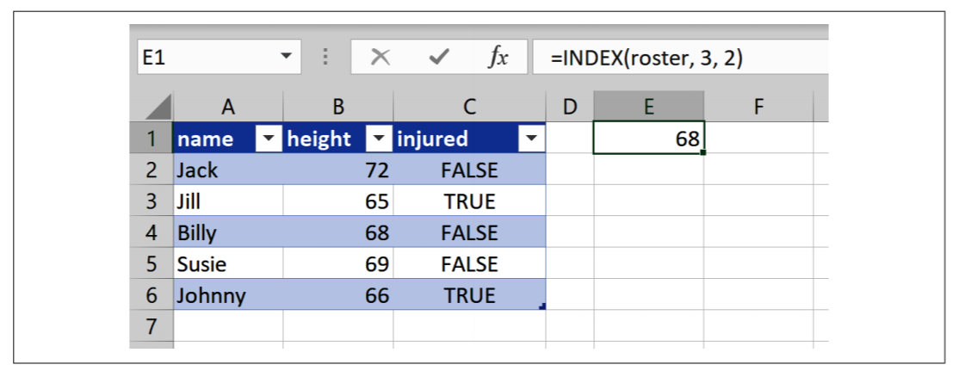
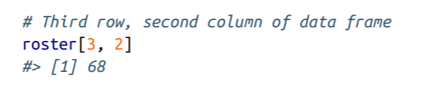
II. FROM EXCEL TO R
6. First Steps with R for Excel Users
7. Data Structures in R
8. Data Manipulation and Visualization in R
9. Capstone: R for Data Analytics
Notes:
Learn about structure

Slide 16
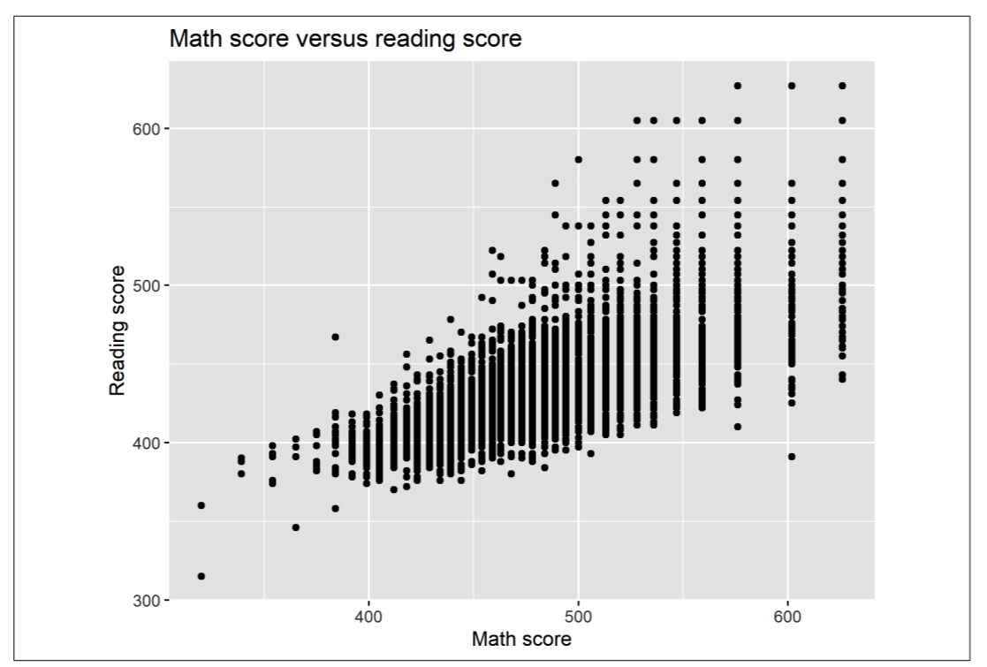
II. FROM EXCEL TO R
6. First Steps with R for Excel Users
7. Data Structures in R
8. Data Manipulation and Visualization in R
9. Capstone: R for Data Analytics
Notes:
Learn some things like rows, filters, joins
Visualizations

Slide 17
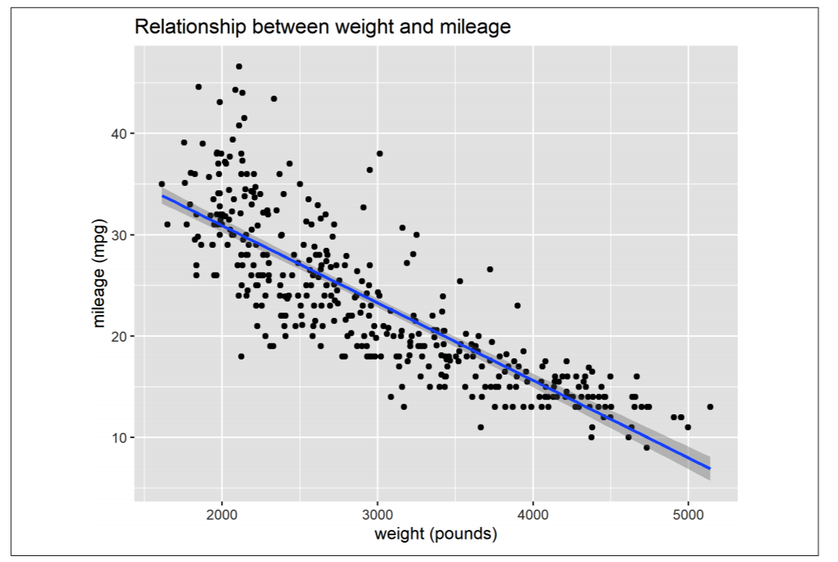
II. FROM EXCEL TO R
6. First Steps with R for Excel Users
7. Data Structures in R
8. Data Manipulation and Visualization in R
9. Capstone: R for Data Analytics
Notes:
Put it all together
Statistical analysis in R so you are able to __________

Slide 18
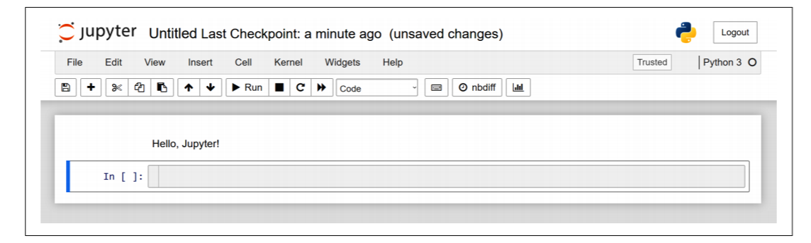
III. FROM EXCEL TO PYTHON
10. First Steps with Python for Excel Users
11. Data Structures in Python
12. Data Manipulation and Visualization in R
13. Capstone: Python for Data Analytics
14. Conclusion and Next Steps
Notes:
And the third part is pretty much Part II but Python. We’ll go through the same steps pretty identically except it will be in Jupyter Notebooks.

Slide 19
CONCLUSION
Notes:
OK now a couple of things, how to get your hands on the book and yes I’ll explain where the bird comes from.

Slide 20
READ IT
FOR FREE
30 days free: https://learning.oreilly.com/get-learning/?code=MOUNT21
Leave a review!
FOR KEEPS
Buy paperback or ebook from various vendors: http://georgejmount.com/book/
Leave a review!
Notes:
Now a couple of options to get the book. First, you can read it for free with a 30-day subscription to O’Reilly Online Learning.
That link will also be at georgejmount.com/book which will have other resources and places to buy the book.
In either case whether it’s O’Reilly Learning or Amazon, wherever, please leave a review if you check it out!

Slide 21
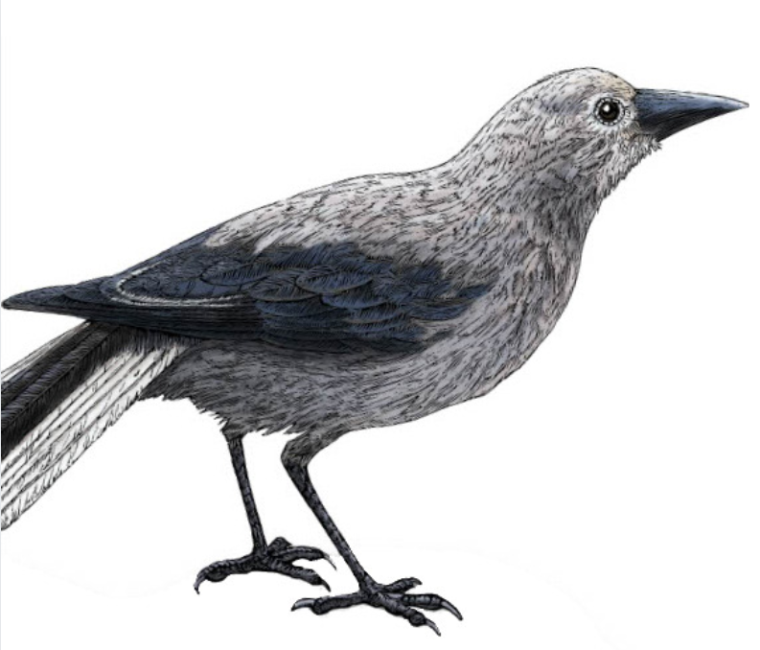
WHAT’S WITH THE BIRD?
Clark’s Nutcracker
Notes:
Now, what’s with the bird. Every O’Reilly book has an animal on the cover. Whether it’s intentional is debatable.
Now this is a Clark’s Nutcracker as in the explorer William Clark in Lewis & Clark fame. What a good bird for a book titled “Advancing into Analytics.”

Slide 22
THANK YOU
LINKEDIN
linkedin.com/in/gjmount
EMAIL ADDRESS
george@stringfestanalytics.com
WEBSITE
stringfestanalytics.com
GITHUB
github.com/summerofgeorge
Notes:
Thanks for coming everyone! I hope this was a good overview for you, looking forward to taking any questions and discussing!

Slide 23
QUESTIONS?
Notes:
Any final questions?

